Slide 1
COT5615: Math for Intelligent Systems I
Anand Rangarajan
Lecture 12

Slide 2
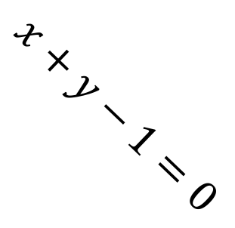
Linear Discriminator
$$x+y−1=0$$

Slide 3
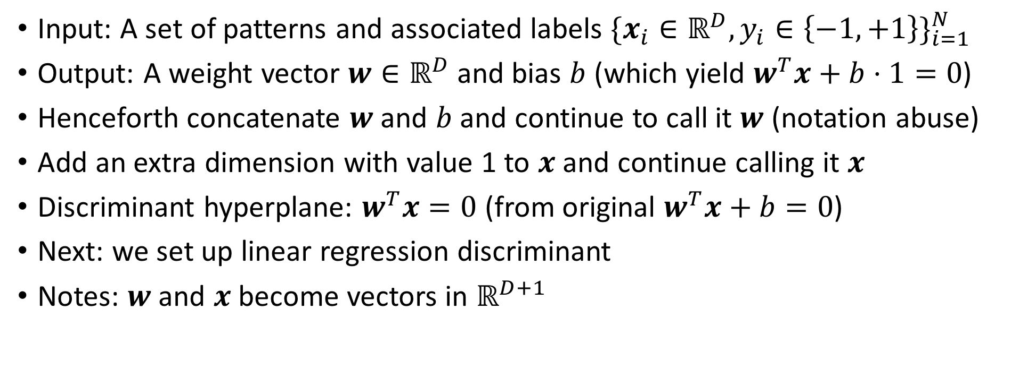
Linear Regression for Supervised Learning
Input: A set of patterns and associated labels $\{x_{i}∈ℝ^{D},y_{i}∈\left\{−1,+1\right\}\}_{i=1}^{N}$
Output: A weight vector $w∈ℝ^{D}$ and bias $b$ (which yield $w^{T}x+b⋅1=0$)
Henceforth concatenate $w$ and $b$ and continue to call it $w$ (notation abuse)
Add an extra dimension with value 1 to $x$ and continue calling it $x$
Discriminant hyperplane: $w^{T}x=0$ (from original $w^{T}x+b=0$)
Next: we set up linear regression discriminant
Notes: $w$ and $x$ become vectors in $ℝ^{D+1}$

Slide 4
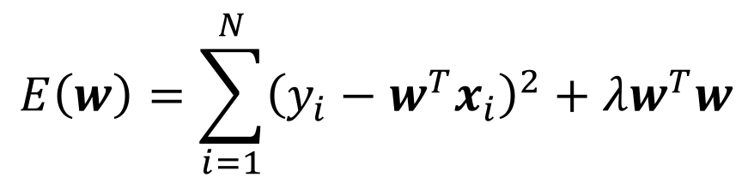
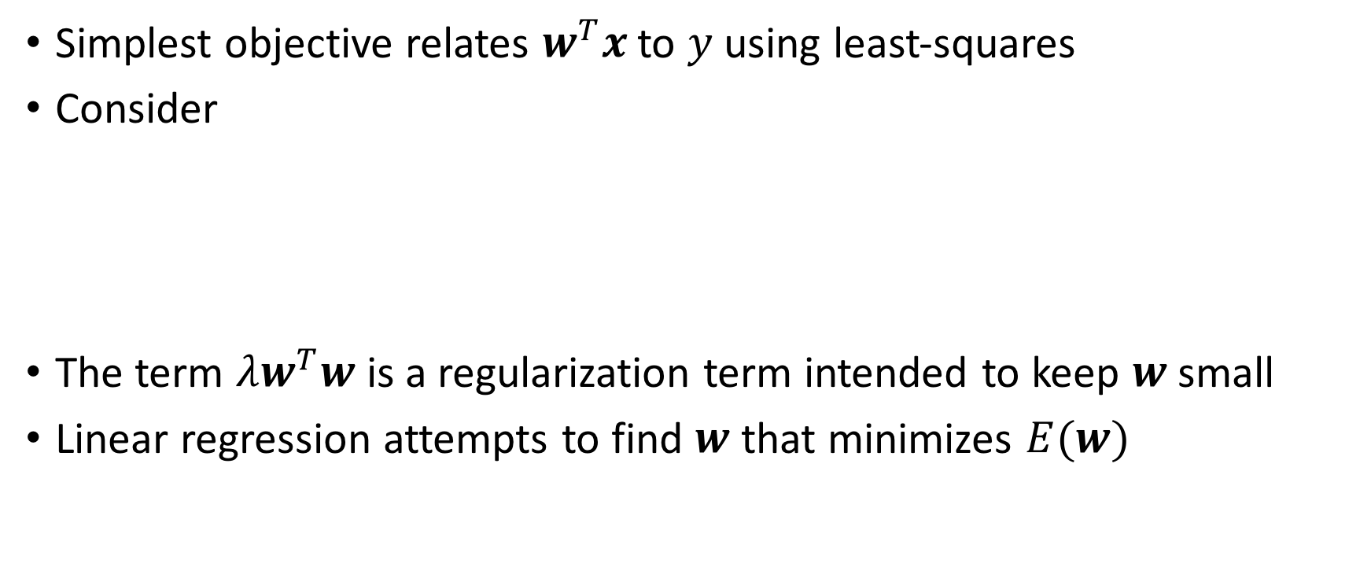
Linear Regression Objective
Simplest objective relates $w^{T}x$ to $y$ using least-squares
Consider
The term $λw^{T}w$ is a regularization term intended to keep $w$ small
Linear regression attempts to find $w$ that minimizes $E(w)$
$$E\left(w\right)=\sum_{i=1}^{N}{{\left(y_{i}−w^{T}x_{i}\right)}^{2}}+λw^{T}w$$

Slide 5

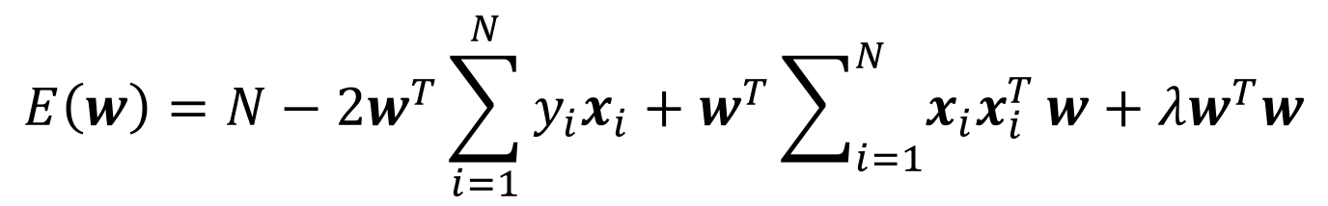
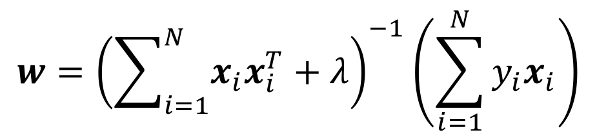
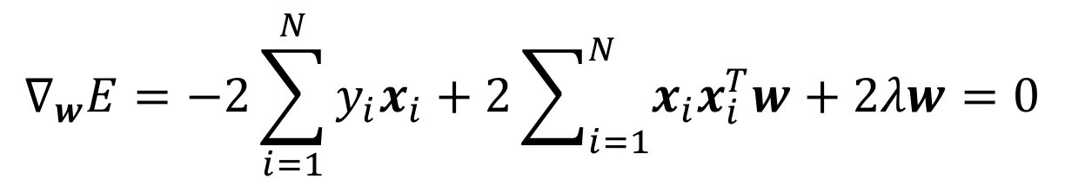
Derivation
$$E\left(w\right)=N−2w^{T}\sum_{i=1}^{N}{y_{i}x_{i}}+w^{T}\sum_{i=1}^{N}{x_{i}x_{i}^{T}}w+λw^{T}w$$
Setting the derivative w.r.t. $w$ to zero, we get
$$∇_{w}E=−2\sum_{i=1}^{N}{y_{i}x_{i}}+2\sum_{i=1}^{N}{x_{i}x_{i}^{T}w+2λw}=0$$
This yields
$$w={\left(\sum_{i=1}^{N}{x_{i}x_{i}^{T}}+λ\right)}^{−1}\left(\sum_{i=1}^{N}{y_{i}x_{i}}\right)$$

Slide 6
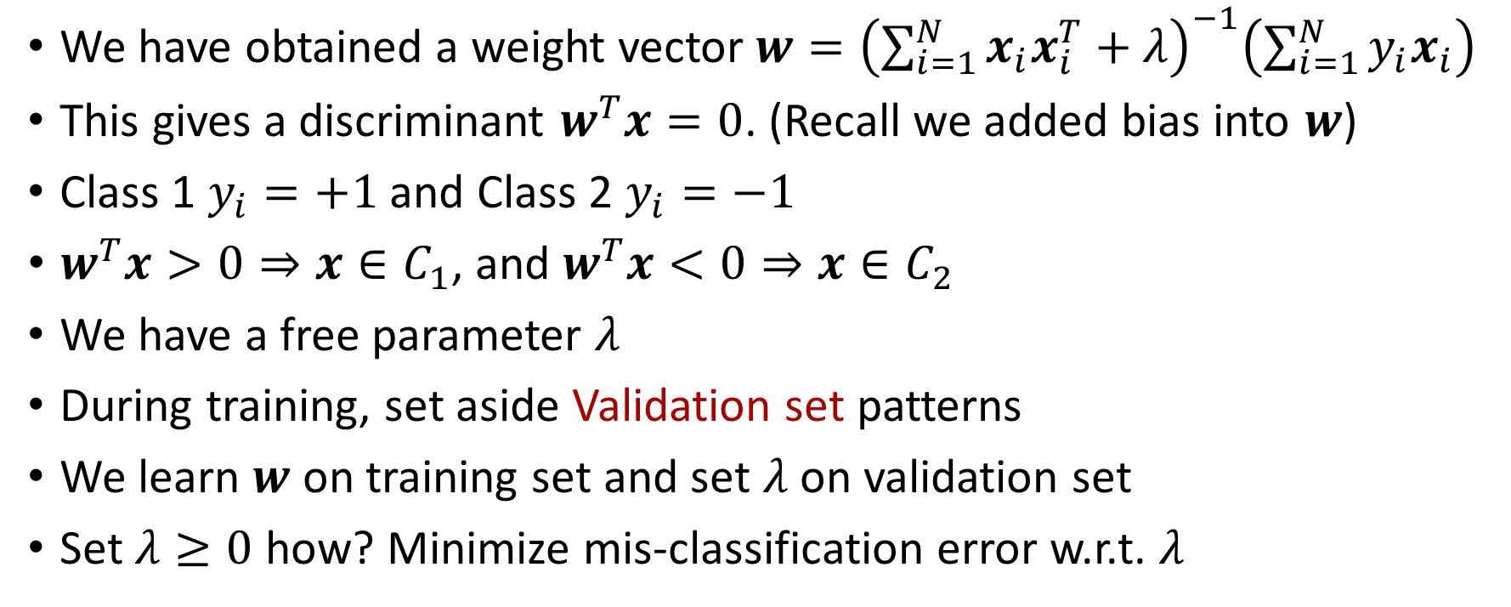
Training
We have obtained a weight vector$w={\left(\sum_{i=1}^{N}{x_{i}x_{i}^{T}}+λ\right)}^{−1}\left(\sum_{i=1}^{N}{y_{i}x_{i}}\right)$
This gives a discriminant $w^{T}x=0$. (Recall we added bias into $w$)
Class 1 $y_{i}=+1$ and Class 2 $y_{i}=−1$
$w^{T}x>0⇒x∈C_{1}$, and $w^{T}x<0⇒x∈C_{2}$
We have a free parameter $λ$
During training, set aside Validation set patterns
We learn $w$ on training set and set $λ$ on validation set
Set $λ≥0$ how? Minimize mis-classification error w.r.t. $λ$

Slide 7
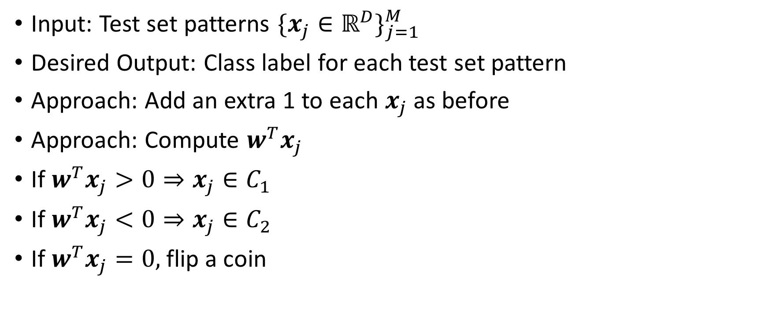
Testing
Input: Test set patterns $\{x_{j}∈ℝ^{D}\}_{j=1}^{M}$
Desired Output: Class label for each test set pattern
Approach: Add an extra 1 to each $x_{j}$ as before
Approach: Compute $w^{T}x_{j}$
If $w^{T}x_{j}>0⇒x_{j}∈C_{1}$
If $w^{T}x_{j}<0⇒x_{j}∈C_{2}$
If $w^{T}x_{j}=0,$ flip a coin

Slide 8
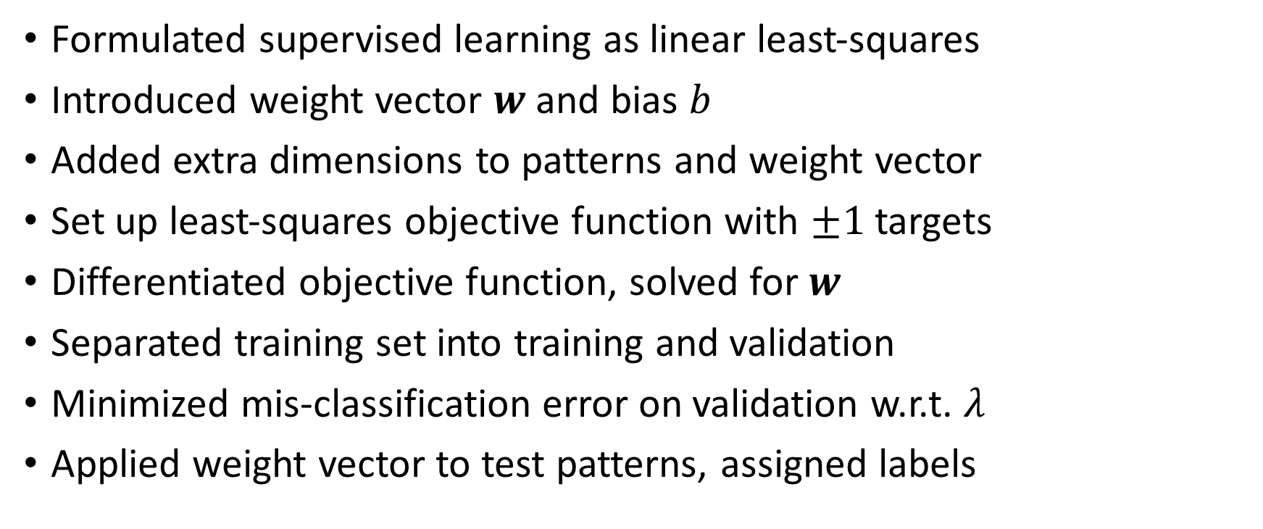
Conclusions
Formulated supervised learning as linear least-squares
Introduced weight vector $w$ and bias $b$
Added extra dimensions to patterns and weight vector
Set up least-squares objective function with $±1$ targets
Differentiated objective function, solved for $w$
Separated training set into training and validation
Minimized mis-classification error on validation w.r.t. $λ$
Applied weight vector to test patterns, assigned labels

Slide 9

Linear Discriminant Example
40 2D patterns for training, 10 patterns for testing
25 patterns from class 1 and same from class 2
No validation set
$λ$ set to 0.001 arbitrarily

Slide 10
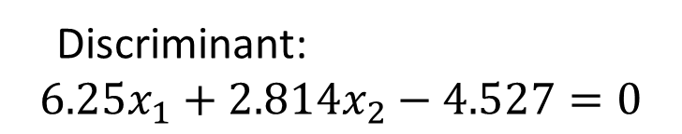
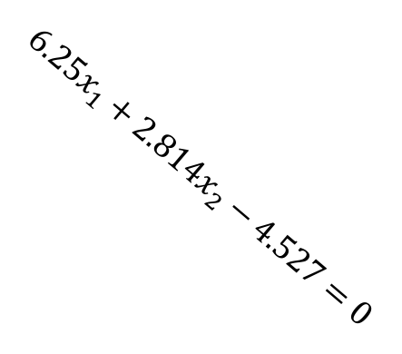
Linear Discriminant Example
Discriminant:
$$6.25x_{1}+2.814x_{2}−4.527=0$$
$$6.25x_{1}+2.814x_{2}−4.527=0$$

Slide 11
Linear Discriminant Code
figure(1)
plot(x1(1:20),x2(1:20),'o')
hold on
plot(x1(26:45),x2(26:45),'x')
plot(x1(21:25),x2(21:25),'b*')
plot(x1(46:50),x2(46:50),'rd')
% Build training set
xt=[x1(1:20),x2(1:20);x1(26:45),x2(26:45)]';
xt = [ones(1,40);xt];
yt=[ones(1,20),-1*ones(1,20)];
lambda=0.001;
% Solve for w
w = inv(xt*xt'+lambda)*(xt*yt')

Slide 12
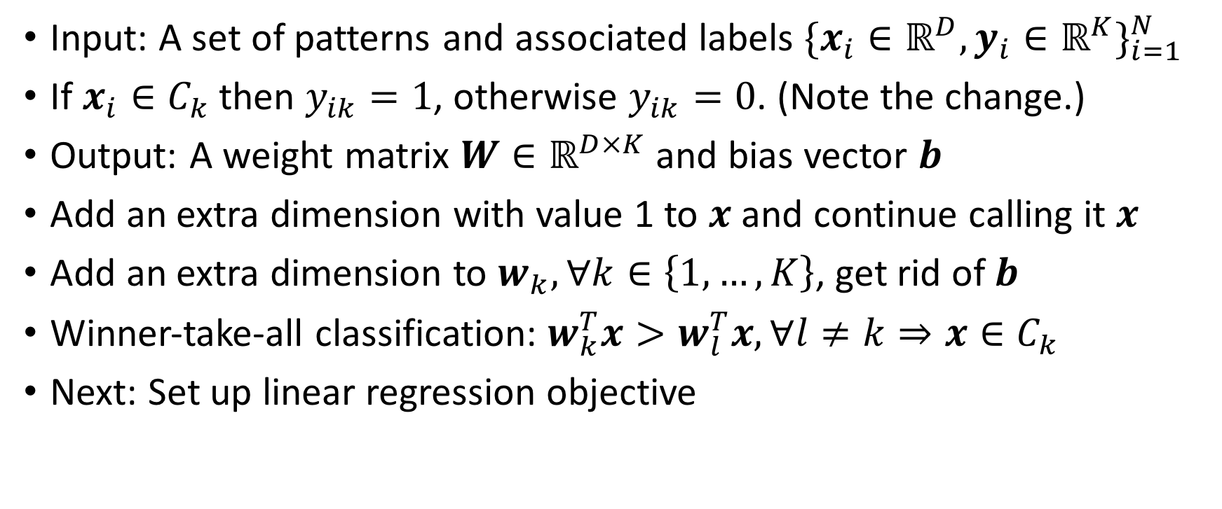
Multiple Classes
Input: A set of patterns and associated labels $\{x_{i}∈ℝ^{D},y_{i}∈ℝ^{K}\}_{i=1}^{N}$
If $x_{i}∈C_{k}$ then $y_{ik}=1$, otherwise $y_{ik}=0$. (Note the change.)
Output: A weight matrix $W∈ℝ^{D×K}$ and bias vector $b$
Add an extra dimension with value 1 to $x$ and continue calling it $x$
Add an extra dimension to $w_{k},∀k∈\left\{1,…,K\right\}$, get rid of $b$
Winner-take-all classification: $w_{k}^{T}x>w_{l}^{T}x,∀l≠k⇒x∈C_{k}$
Next: Set up linear regression objective

Slide 13
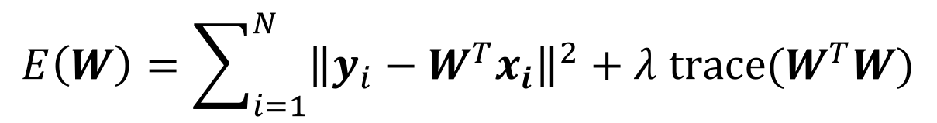
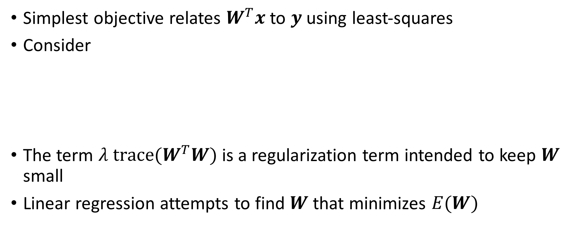
Multiple Class Linear Regression Objective
Simplest objective relates $W^{T}x$ to $y$ using least-squares
Consider
The term $λ trace(W^{T}W)$ is a regularization term intended to keep $W$ small
Linear regression attempts to find $W$ that minimizes $E(W)$
$$E\left(W\right)=\sum_{i=1}^{N}{{\left\|y_{i}−W^{T}x_{i}\right\|}^{2}+λ trace(W^{T}W)}$$

Slide 14

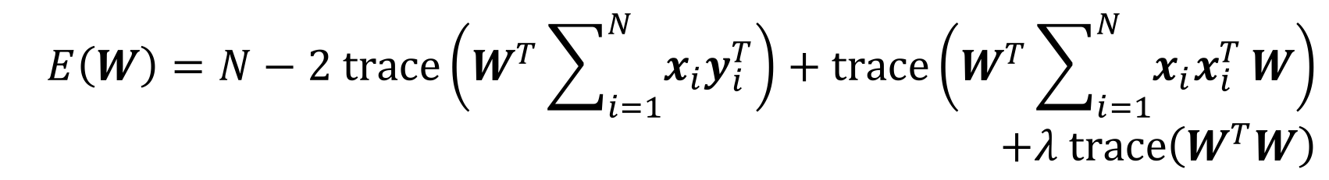
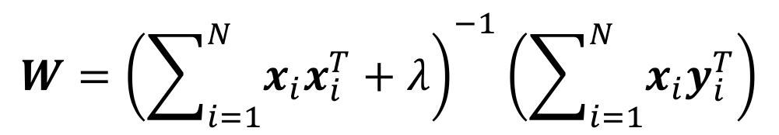
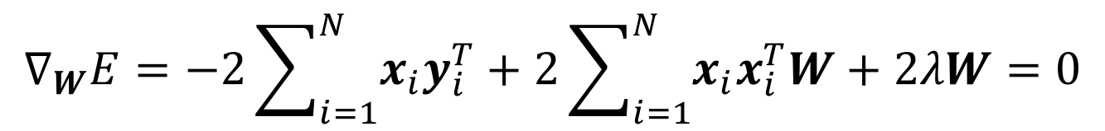
Derivation
$$E\left(W\right)=N−2 trace\left(W^{T}\sum_{i=1}^{N}{x_{i}y_{i}^{T}}\right)+trace\left(W^{T}\sum_{i=1}^{N}{x_{i}x_{i}^{T}}W\right) \\ +λ trace\left(W^{T}W\right)$$
Setting the derivative w.r.t. $W$ to zero, we get
$$∇_{W}E=−2\sum_{i=1}^{N}{x_{i}y_{i}^{T}}+2\sum_{i=1}^{N}{x_{i}x_{i}^{T}W+2λW}=0$$
This yields
$$W={\left(\sum_{i=1}^{N}{x_{i}x_{i}^{T}}+λ\right)}^{−1}\left(\sum_{i=1}^{N}{x_{i}y_{i}^{T}}\right)$$

Slide 15
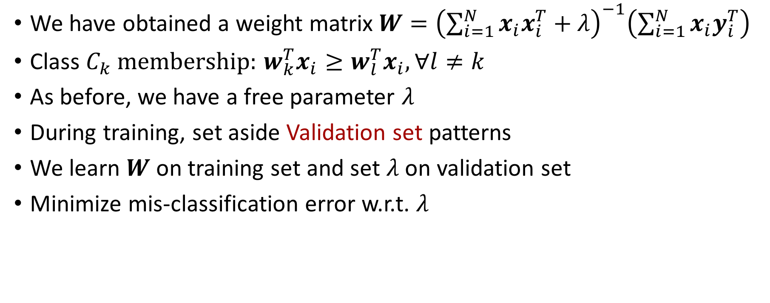
Training
We have obtained a weight matrix$W={\left(\sum_{i=1}^{N}{x_{i}x_{i}^{T}}+λ\right)}^{−1}\left(\sum_{i=1}^{N}{x_{i}y_{i}^{T}}\right)$
Class $C_{k}$ membership: $w_{k}^{T}x_{i}≥w_{l}^{T}x_{i},∀l≠k$
As before, we have a free parameter $λ$
During training, set aside Validation set patterns
We learn $W$ on training set and set $λ$ on validation set
Minimize mis-classification error w.r.t. $λ$

Slide 16
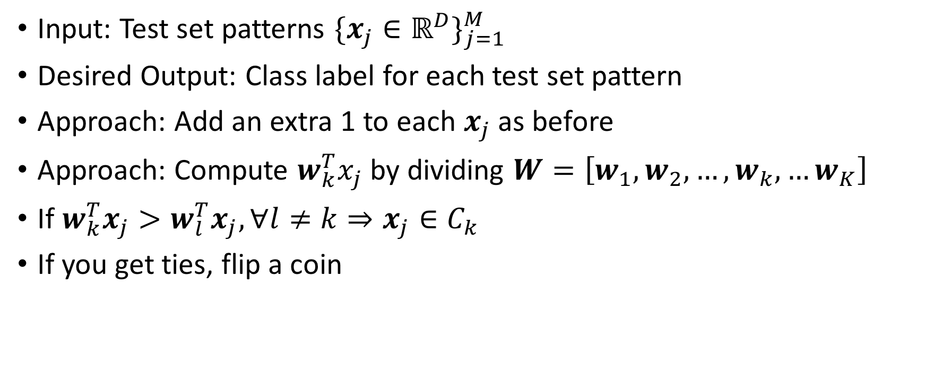
Testing
Input: Test set patterns $\{x_{j}∈ℝ^{D}\}_{j=1}^{M}$
Desired Output: Class label for each test set pattern
Approach: Add an extra 1 to each $x_{j}$ as before
Approach: Compute $w_{k}^{T}x_{j}$ by dividing $W=\left[w_{1},w_{2},…,w_{k},…w_{K}\right]$
If $w_{k}^{T}x_{j}>w_{l}^{T}x_{j},∀l≠k⇒x_{j}∈C_{k}$
If you get ties, flip a coin

Slide 17
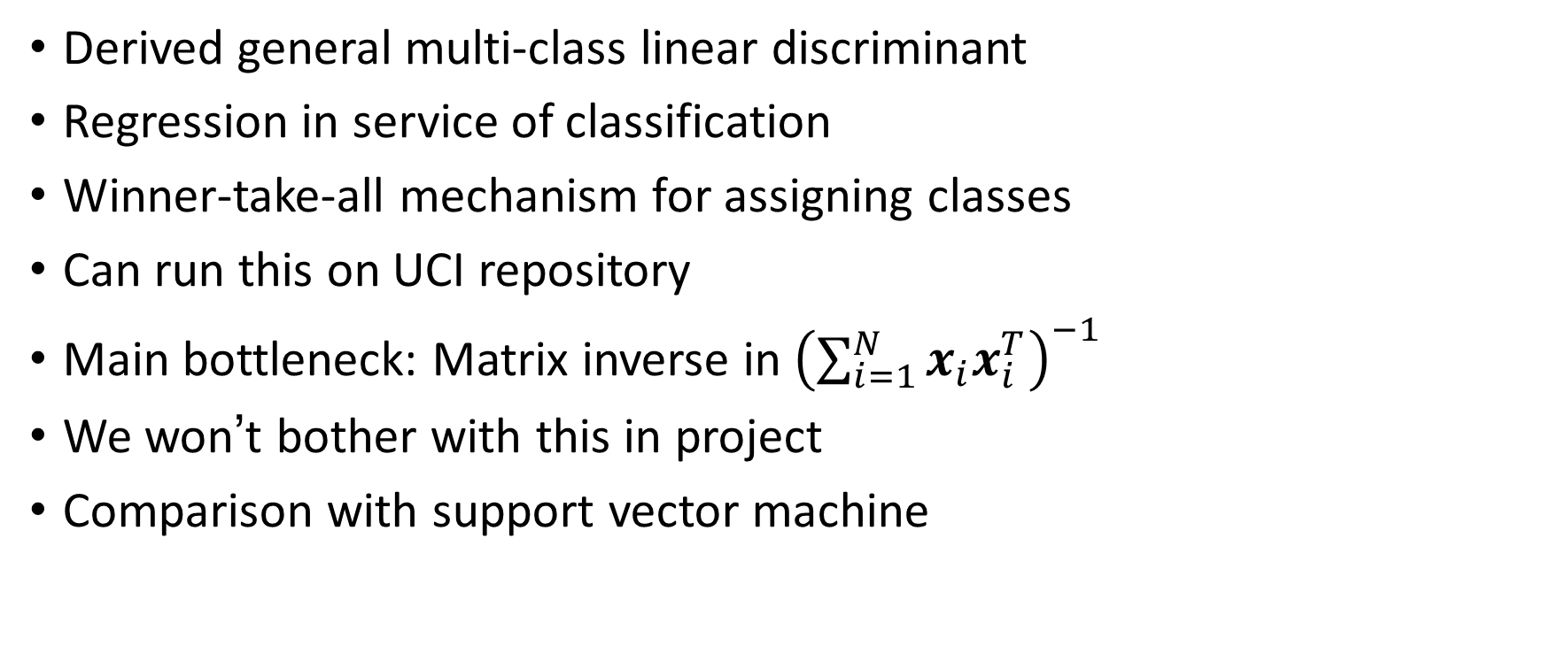
Conclusions
Derived general multi-class linear discriminant
Regression in service of classification
Winner-take-all mechanism for assigning classes
Can run this on UCI repository
Main bottleneck: Matrix inverse in ${\left(\sum_{i=1}^{N}{x_{i}x_{i}^{T}}\right)}^{−1}$
We won’t bother with this in project
Comparison with support vector machine

